Slide 1
Prognóza Exportu Raiffeisenbank a Asociace exportérů
Praha 9. 1. 2019

Slide 2
Company history
1992 Delong Instruments s.r.o
2002 DELONG INSTRUMENTS a.s.
2007 Nová provozní budova Brno
2015 Nové Čisté prostory Brno - Purkyňova
2017 Nová provozní budova Boskovice

Slide 3
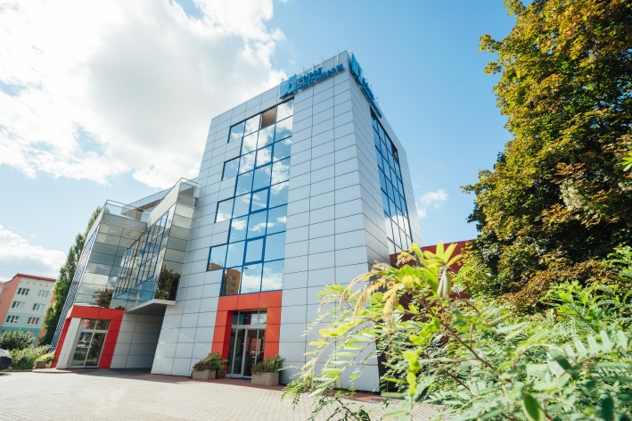
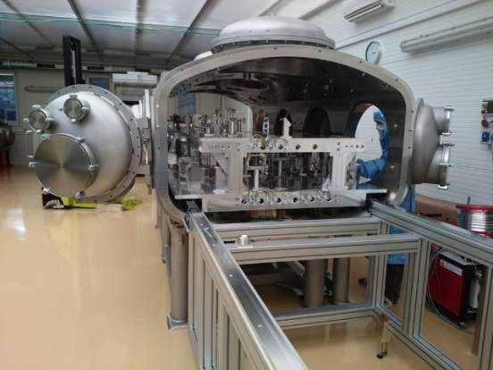
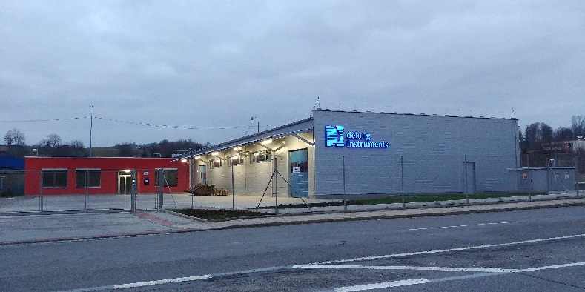
Company location
  Brno – Palackého tř.
      Headquarters
      R & D
      Special manufacturing technology
      Assembly
      Testing
  Boskovice
      Manufacturing
      Complex technology
  Brno - Purkyňova
      Large components: clean assembly and test

Slide 4
Production structure
  Components
  manufacturing 18 %
  End user products 52 %
    LVEM 5
    LVEM 25
    DIGUN
  OEM products 30 %
    Semiconductor industry
    Analytical instruments
    Laser application
    Nanostructures
    Vacuum systems
    Prototype and unique systems
All categories include Development services

Slide 5
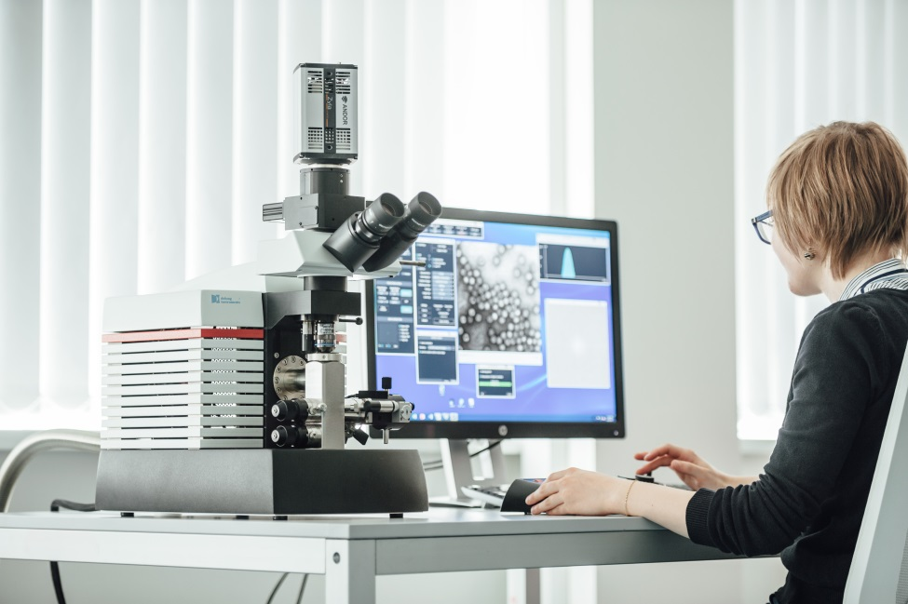

End User Products LVEM 5 table-top TEM
Powerful transmission electron microscope.
The LVEM 5 combines transmission (TEM, STEM) and scanning (SEM) modes as well as electron diffraction (SAED).
It operates with low accelerating voltage (5 kV) which brings high contrast on light elements.
Resolution of 1.2 nm.
Biological and soft matter applications.
High contrast without staining.
Low accelerating voltage allows a very small optics column.
Can be installed on a regular desk – small installation space needed.
Does not require neither a dark room nor cooling water.

Slide 6
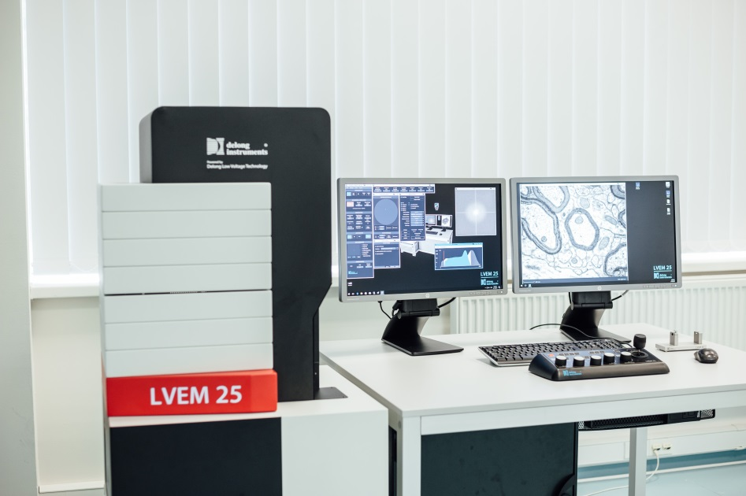

End User Products LVEM 25 - TEM
Powerful transmission electron microscope.
The LVEM 25 combines transmission TEM and STEM modes.
It operates with low accelerating voltage (25 kV) which brings enhanced contrast on light elements.
Resolution of 1 nm.
Biological and soft matter applications.
High contrast of light elements.
Imaging possible both with and without staining.
Easy to control.
Small installation space.
Can be installed in an ordinary lab without any need for a dark room or cooling water. It can be supplied even as a mobile work-station.

Slide 7
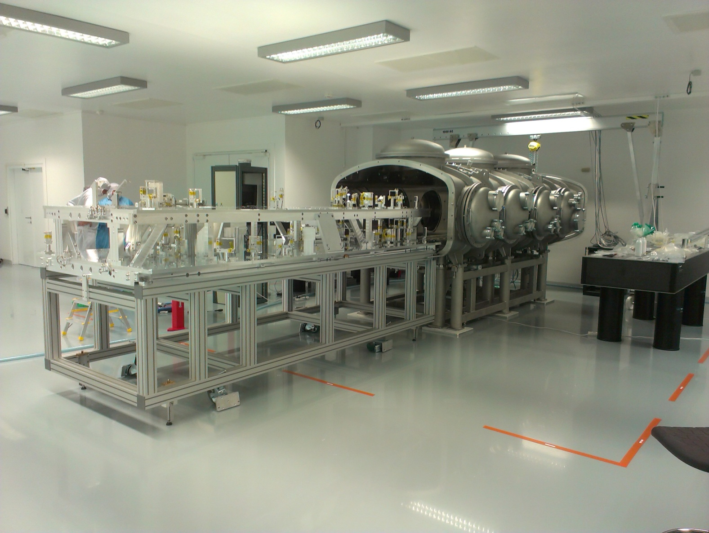
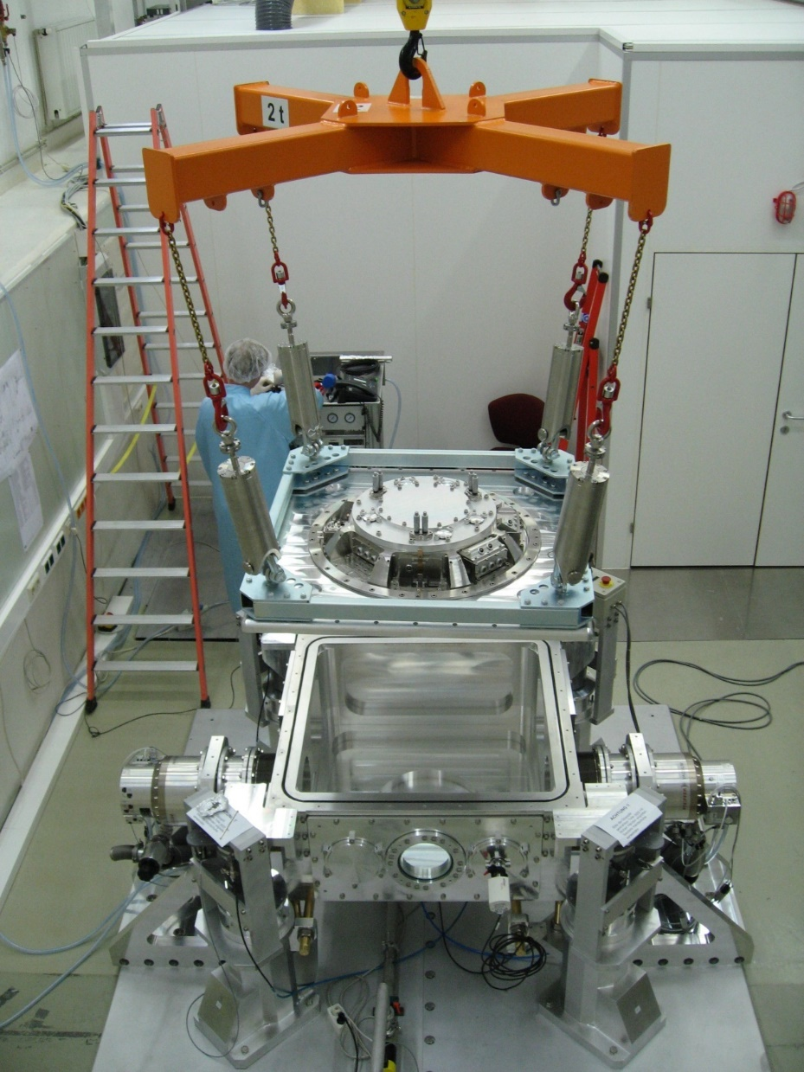
Other Products

Slide 8
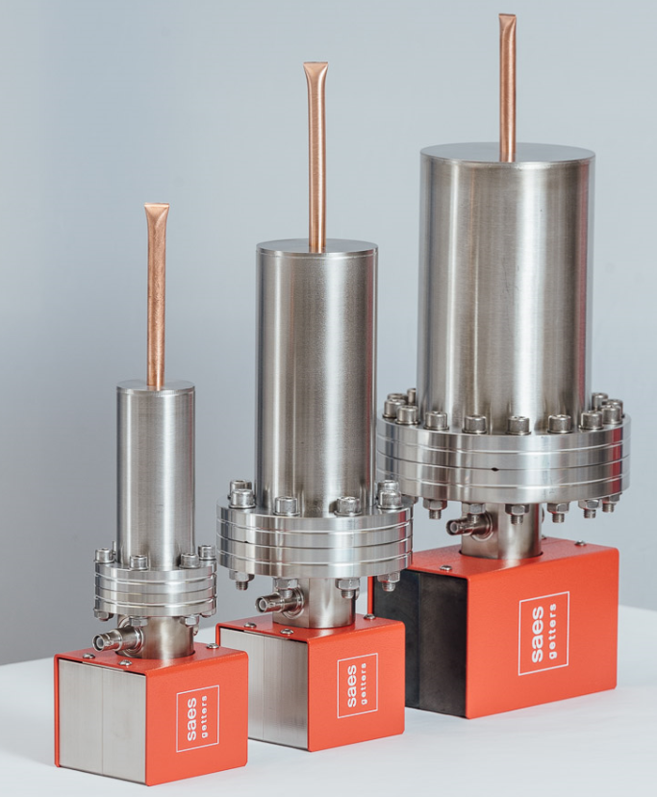
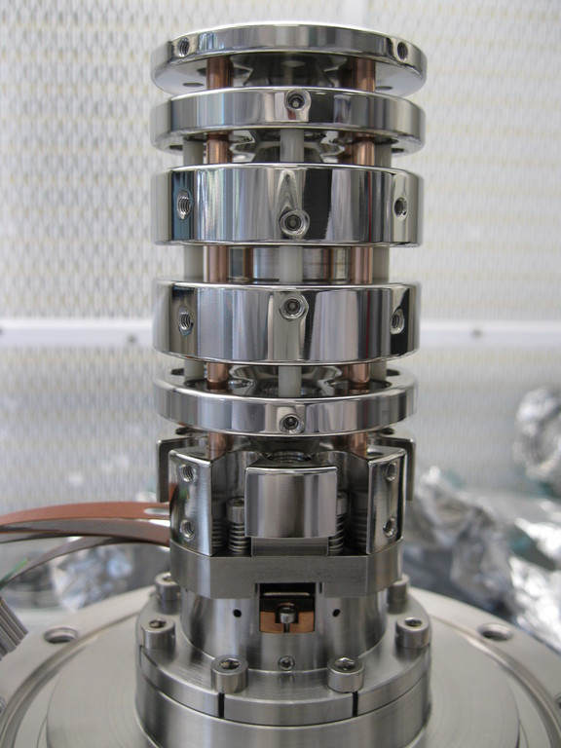
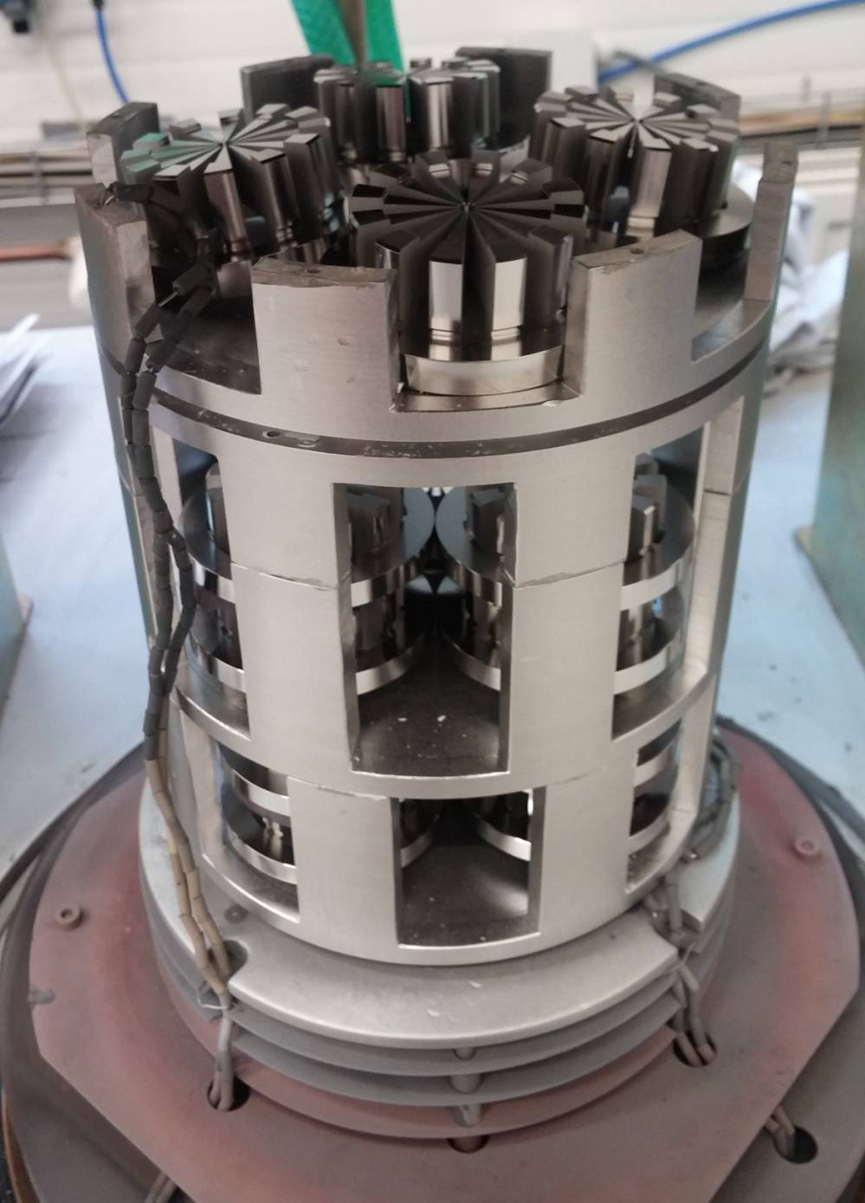
Other Products
CONFIDENTIAL

Slide 9
Personnel structure

Slide 10
Financial data

Slide 11
Financial data
Total EXPORT 86,2 %

Slide 12
Děkuji za pozornost ing. Tomáš Papírek, člen představenstva tomas.papirek@delong.cz www.delong.cz
Sídlo: Palackého tř. 153b, 61200 Brno

